Slide 1

The Profession of Nursing
Notes:
Nursing is a profession with many career opportunities. In the past, nursing was viewed primarily in terms of direct patient care roles, mainly in hospitals. As the health field is changing so are the roles of nurses and the places in which nurses practice. Nearly 50% of nurses now work in settings outside of hospitals. They may be employed in long-term care facilities, home health care agencies, industry, schools, armed forces and physician’s offices. Licensed practical nurses complete a diploma program in one to one and a half years. Registered nurses may complete an Associate Degree or Bachelor’s degree program in 2 to 4 years. Both types of nurses complete a National Exam at the end of their that qualifies them for a nursing license.

Slide 2
Levels of Nursing Careers
Nurse Assistant, Home Health Care Assistant, Medication Aid, Certified Nurse Technician
  76-120 hour state approved program
Licensed Practical Nurse (LPN)
  1-2 year state approved program
  Licensure in state practicing
Registered Nurse (RN)
  2-3 year diploma program
  Associate degree or Bachelor degree
  Licensure in state practicing

Slide 3
Other Health Care Professions
Medication aides/assistants
Medical Assisting
Medical Laboratory Technician
Health Information Management Services
Emergency Medical Technicians / Paramedicine
Occupational Therapy Assistance
Notes:
Nurse Assistance (nurse aides) and Patient care technicians (PCTs) work under the supervision of RNs or LPNs. They provide patient care such as baths, bed making, and feeding; assist in transfer and ambulation; and administer basic treatments.
Geriatric aides/assistants – acquire additional education to provide care for the elderly in work environments such as extended care facilities, nursing homes, retirement centers, adult daycare agencies, and other similar agencies.
Home Health Care assistants are trained to work in the patient’s home and may perform additional duties such as meal preparation or cleaning.
Medication aids/assistants received special training such as a 40 hour or more state approved medication aide course to administer medications to patients or residents in long-term care facilities or patients receiving home health care. Most states that have the medication aid program require that the aid be on the state approved list for nurse or geriatric assistants before taking the medication aide course. In addition, many states require a competency test (more to follow in Unit 6).
Each nursing assistant working in a long term care facility or home health care is now required under federal law to complete a mandatory, state approved training program and pass a written and/or competency examination to obtain certification or registration. Health workers in these environments should check the requirements of their respective states.

Slide 4
Place of Employment
Hospitals
Psychiatric hospitals
Home health care agencies
Public health departments
Crisis or counseling centers
Drug and alcohol treatment facilities
Prisons
Educational institutions
Long term care facilities
Rehabilitation centers
Physicians offices
Health maintenance organizations (HMO’s)
Industry
Notes:
Hospitals are one of the major types of health care facilities. They vary in size and types of service provided. Some hospitals are small and serve the basic needs of a community; others are large, complex centers offering a wide range of services including diagnosis, treatment, education, and research (UNMC). Hospitals are also classified as private or proprietary (operated for profit), religious, nonprofit or voluntary, and government, depending on the sources on income received by the hospital.
Clinics, also called satellite clinics or satellite centers, are health care facilities found in many types of health care. Some clinics are composed of a group of medical or dental doctors who share a facility and other personnel. Other clinics are operated by private groups who provide special care.
Examples:
Surgical clinics: perform minor surgical procedures; frequently called “one day” surgical centers because patients are sent home immediately after they recover from their operation
Urgent or emergency care clinics: provide first aid or emergency care to ill or injured patients
Rehabilitation clinics: offer physical, occupational, speech, and other similar therapies
Specialty clinics: provide care for specific diseases; examples include diabetic clinics, kidney dialysis centers, and oncology (cancer( clinics
Outpatient clinics: usually operated by hospitals or large medical groups; provide care for outpatients (patients who are not admitted to the hospital)
Health department clinics: may offer clinics for pediatric health care, treatment of sexually transmitted diseases and respiratory disease, immunizations, and other special services
Medical center clinics: usually located in colleges or universities; offer clinics for various health conditions; offer care and treatment and provide learning experience for medical students.

Slide 5
Medical Offices
Services
  Diagnosis
  Treatment
  Examination
  Basic laboratory
  Minor surgery
Specialties
  Pediatrics
  Cardiology
  Obstetrics
Notes:
Medical offices vary from offices that are privately owned by one doctor to large complexes that operate as corporations and employ many doctors and other health care professionals. Medical services obtained in these facilities can include diagnosis (determining the nature of an illness), treatment, examination, basic laboratory testing, minor surgery, and other similar care. Some medical doctors treat a wide variety of illnesses and age groups, but others specialize in and handle only certain age groups or conditions.
Examples of specialties include: pediatrics (infants and children), cardiology (diseases and disorders of the heart), and obstetrics (care of the pregnant female).

Slide 6
Home Health Care
Provide care in a patient’s home
Services:
  Nursing care
  Personal care
  Therapy
  homemaking
Used by:
  Health departments
  Hospitals
  Private agencies and Government agencies
  Nonprofit or volunteer groups
Notes:
Home health care agencies are designed to provide care in a patient’s home. The services of these agencies are frequently used by the elderly and disabled.
Examples of such services include nursing care, personal care, therapy (physical, occupational, speech, respiratory) and homemaking (food preparation, cleaning, and other household tasks).
Health departments, hospitals, private agencies, government agencies, and nonprofit or volunteer groups can offer home care services.

Slide 7
Formal nursing education:
Nurse Assistant (Aide)
  16 yrs. old, 76 Hr., $300
  Pay $7-10 / hr.
Practical Nursing (LPN)
  42 Credits 1 yr., $7,000
  Bedside nursing care & meds
  Pay $12-$17 / hr.
Registered Nurse (RN)
  AD/RN: 72 Credits 2-3 yr.,$10,000
  BSN:128 Credits 4-5 yr., $60,000
  Staff nursing & Management
  Pay $15-$22 / hr.
Nurse Specialties
  MSN in Nursing Education
  MSN as a Nurse Practitioner
  Doctoral Degree
Notes:
Various levels of education can be completed in the nursing profession. The slide shows some basic information about Nurse Aide, LPN, and RN training with approximate salaries per hour. Credit hours are listed with the approximate cost of the education and beginning salaries for new graduates of the programs. Master’s Degrees may also be obtained that can prepare nurses to function in as a nurse educator, a nurse practitioner, a nurse anesthetist, a clinical nurse specialist, or a nurse midwife. Doctoral degrees in education and research are also available.

Slide 8

The role of a Nurse assistant (Aide)
The right attitude:
State of NE requirements:
Physically demanding
Emotionally challenging
Good work ethic
Complete 76-hour training
Pass state exam
Placement on Nurse Aide Registry
Adherence to facility’s rules and regulations
Must be 16
Speak and understand English language
No crimes related to role of Nurse Aide
Notes:
It takes a special person to work as a nursing assistant. The job is physically as well as emotionally challenging. Some qualities of a successful nursing assistant include being sensitive, mature, patient, reliable, and having an optimistic attitude.
To show a level of maturity, attend to patients’ needs before one’s own—this is important to being successful in any personal service role. Furthermore, mature staff is able to recognize helpful criticism and use it to improve their position as a nursing assistant. Nursing assistants should always show patience by encouraging residents to do things for themselves. Even though it may be easier or quicker to perform a certain task for your patient or resident, it is important to remain patient. The patient’s self-esteem and independence are therefore supported and respected.
Nurse aides must be prompt for work and abide by facility rules and regulations. This reliable characteristic is valued in the workplace. In addition, she/he should always strive to do their best when completing assignments and working with patients. Furthermore, working with an upbeat attitude is central to being a successful member of the healthcare team. A positive outlook is perhaps the most significant quality of a good nursing assistant.
Your instruction and training will prepare you to perform nursing assistant procedures. In Nebraska, a nurse aid/nursing assistant student must complete a state approved 76 hour training course and competency training program (a competency evaluation program consists of passing a written and skills test) and be listed on the nurse aid registry. After successful completion of the state tests, the individual’s name will automatically be placed on the state Nurse Aide Registry, which takes place within 30 days after the department is notified of achievement. Requirements for placement on the Nebraska nurse aid registry include the following:
Be at least 16 years of age
Be able to speak and understand the English language
Must not have been convicted of a crime rationally related to the role of a nurse aid involving immoral behavior, dishonesty, or contrary to justice.

Slide 9
Skills learned and demonstrated
Bed making
Hand washing
Gloving procedure
Bed bath
Moving and transferring residents
Vital Signs (temperature, radial pulse, blood pressure, respiration)
Notes:
Throughout your Nursing Assistant coursework, there will be a number of skills and competencies to learn and demonstrate for instructors. Any physical condition limiting your ability to successfully perform any of these procedures should be considered and discussed.
Assisting the patient and resident to meet physical needs and activities of daily living (ADL’s). As nursing assistants, you will spend most of your time doing this type of work. Remember to encourage patients and residents to be as independent as possible and perform only what they are unable to do for themselves.
It is important to practice each of the skills and procedures to en sure proficiency as these skills mirror the competency testing skills for the State exam.

Slide 10
Duties
A Nurse Aide performs functions related to the personal, safety, nutrition, exercise and elimination needs of patients and/or residents
  Provide clean, homelike atmosphere
  Maintain safe environment - observe for problems or changes
  Assist with activities of daily living (ADL’s)
  Support emotional and social needs
  Admission/discharge procedures
Notes:
The Nursing assistant’s overall job responsibilities include the following:
Following facility rules to ensure safe care for the patient and resident as well as preventing illness or injury to workers.
The compassionate nursing assistant is aware of the emotional needs of each patient and helps patients feel protected, important and respected.
Observing each patient and resident for problems or changes. The nursing assistants frequently know patients and residents better than anyone else on the healthcare team; hence, the nursing assistant is often the nurse’s eyes and ears. It is important to keep in mind that the health of patients and residents benefit from the early reporting and close observations of the NA.
Other job responsibilities of nursing assistants may include assisting with the admission and discharge processes of patients and residents in addition to measuring and recording vital signs, such as temperatures, pulses, respirations, and blood pressures.
You may not be authorized to perform certain procedures by your employer. On the other hand, other facilities may want you to perform things that you did not learn during your schooling. You can do additional procedures and tasks if:
You are provided the required education and training
You are provided the necessary supervision
The procedure or task is within the scope of nursing assistant practice in your state

Slide 11
Lifelong learner
No in-service necessary
No continuing education needed
12 hours in-service required by Medicare/Medicaid facilities
REPORTING AND RECORDING OBSERVATIONS
Reporting and recording
  Reporting—verbal account of care and observations
  Recording (charting)—written account of observations and care given
Notes:
Although there is no in-service or continuing education requirements for maintaining an active status on the nurse aide registry, nursing assistants should continue to learn, improve, and grow in this key role.
CNAs give residents important social and emotional support and also provide vital information on patient conditions to nurses.

Slide 12
What can’t a Nurse Assistant do?
Give medications
Take orders from physician
Oversee other Nurse Aides
Disclose personal information about patient
Duties outside Nurse Aide’s scope of practice
Notes:
There are restrictions to what the NA is allowed to perform. Some of these limits include:
Never give medications. There have been occurrences when a nurse has brought a medication to a patient’s room while the patient was in the bathroom or busy with another activity. The nurse then instructed the nursing assistant to give the medication to the patient later. In this circumstance (and other related situations) the NA should respectfully but definitely decline this nurse’s order. If the NA performed this task, they would not be following the scope of practice outlined for their role.
Never receive oral or telephone orders from physicians. Perhaps you might answer the telephone or be near a doctor who wants to give an order to you. You will need to politely give your name and title, request the doctor to wait and promptly find a nurse to speak with the doctor.
Never take charge of other nursing assistants. Nurses are legally accountable for supervising the work of nursing assistants. NAs are not trained or paid to supervise the work of others. Furthermore, overseeing other NAs can result in legal consequences.
Never disclose the patient’s or resident’s diagnosis, medical or surgical treatment plans to the patient, resident, or family. The physician is in charge of informing this information to the patient, resident, and family. Nurses are allowed to further explain or clarify what the physician has expressed if needed.
Never perform something that you cannot do or that is beyond the scope of nursing assistants. Without delay, explain to the nurse why you cannot complete the order or request. The nurse will assume you are doing what you were asked to do unless you explain otherwise. The care of patients and residents should never be ignored.

Slide 13
Regulations
Proper training of health care providers
Employee protection at employment site
Standards of cleanliness and quality
Health care access
Notes:
Regulations and laws from federal, state, and local government must be followed by all health care facilities. The purpose of this is to watch over the public.
Properly trained health care providers ensures competency and improves their performance. For employee protection, Occupational Safety and
Health Administration (OSHA) establishes safety and health standards for the workplace environment.
Government agencies focus on facilities meeting standards of cleanliness and quality as well as health care access.

Slide 14
Placement on Nebraska Nurse Assistant Registry
Completion of nurse assistant course
Completion of competency exams
Completion of basic resident care course
Continue active status on nurse aide registry
  Work as a nurse assistant (aide)
    Nursing facility, hospital, home care
  Provide nursing or nursing support
    Within scope of nursing assistant practice
Notes:
An individual who successfully completes a state approved nurse aide course and competency evaluation program or a basic resident care course through either a facility or non-facility based program, does not need to complete an application.
The individual’s name is automatically added to the registry within 30 days after the department is notified of successful completion of both the written and skills exams.

Slide 15
ABC’s of a Successful Nursing Assistant
A good employee = A good Nursing Assistant
  An employer expects :
    Elect to be at work every day. Notify supervisor when ill.
    Correct dress and good personal hygiene
    Do the job to the best ability
    Follow the rules of the facility
    A positive attitude about self, job, and employer
    Get along with the rest of the staff
    Honor the residents as individuals who deserve respect

Slide 16
Licensed Practical Nurses (LPNs)
Work under the supervision of physicians or RNs
Provide patient care requiring technical knowledge (but not the level of education of an RN)
Care determined by work environment
State laws regulate the extent of duties
www.discovernursing.com
Notes:
Licensed practical nurses work under the supervision of registered nurses, physicians, dentists, osteopaths or podiatrists.
Various work environments:
Home
Hospital
Long term care facilities
Adult daycare center
Physician’s office
Clinic
Wellness center
Health maintenance organization

Slide 17
Graduates of the Practical Nursing Program are prepared to:
Apply critical thinking skills to assist with the steps of the nursing process to provide appropriate care in response to the health-illness continuum.
Use therapeutic communication techniques with individuals, families, groups, and members of the health care team.
Demonstrate positive role behaviors and caring attitudes reflecting a commitment to ensure high standards of nursing practice.
Demonstrate safe performance of required nursing skills.
Use a patient-centered approach when providing nursing care for individuals, families, and groups respecting cultural, spiritual and ethnic diversity.
Review the nursing literature to apply evidence-based practice to nursing care.
Utilize informatics to communicate, manage knowledge, mitigate error, and support decision-making.
Collaborate with members of the interdisciplinary health care team and contribute to continuous quality improvement.

Slide 18
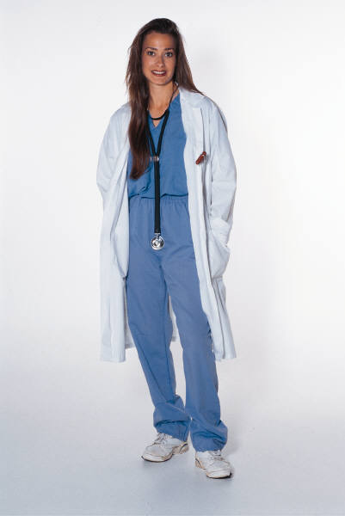
Why would anyone want to be a nurse?
Life long profession
Employment possibilities
Personal satisfaction
Notes:
There are many opportunities for nurses with a predicted nursing shortage of 200,000 RNs and nearly as many LPNs by the year 2014 in the United States alone. This shortage is due to a rapidly aging population of “baby boomers” that require health care services, the retirement of many nurses currently in the workforce, and new roles that have developed for nurses outside of the hospital setting requiring a larger number of nurses in the workforce. There are global shortages as well. There is much satisfaction in helping those in need.

Slide 19
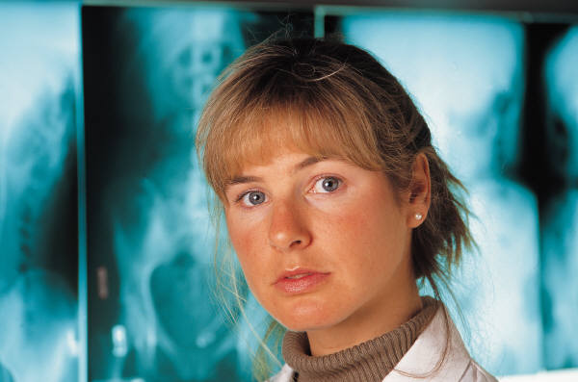
What does it take to be a nurse?
Compassion & Dedication
Work ethics
Formal nursing education
Strong knowledge base
Strong knowledge base in:
Anatomy and Physiology
Communication Skills
Math: Medication dosage calculations
Science, Microbiology, Chemistry
Notes:
Nursing requires a good knowledge base, technical skills, critical thinking, and the ability to be caring and compassionate to those in need. Advances in technology require that nurses gain expertise in managing and documenting care as well.

Slide 20


Duties of the nurse
Assisting Physicians
Medication administration
Injections
Record Keeping
Prevention of the spread of disease
IV administration and calculations
Notes:
One of the duties of a nurse is assisting physicians as they carry out medical treatment. Nurses who work in the operating room help by providing a sterile environment, collecting specimens, preparing instruments, and assisting with a multitude of tasks to help the surgery go well so that the patient can get well

Slide 21
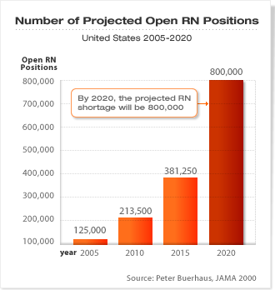
Registered Nurses (RNs)
Nurse practitioners (CRNPs)
Nurse Midwives (CNMs)
Nurse educators
Nurse anesthetists
Clinical nurse specialists (CNSs)
Notes:
Registered Nurses work under the direction of physicians and provide total care to patients. The RN observes patients, assesses patients’ needs, reports to other health care personnel, administers prescribed medications and treatments, teaches health care, and supervises other nursing personnel. The type of facility determines specific job duties. Registered nurses with an advanced education can specialize.
Examples of Advanced practice nurses include:
Nurse practitioners
Take health histories
Perform basic physical examinations
Order laboratory tests and other procedures
Refer patients to physicians
Help establish treatment plans
Treat common illnesses such as colds or sore throats
Teach and promote optimal health
Nurse midwives
Provide total care for normal pregnancies
Examine the pregnant women at regular intervals
Perform routine tests
Teach childbirth and childcare classes
Monitor the infant and mother during childbirth
Deliver the infant
Refer any problems to the physician
Nurse educators
Teach in HSTE programs, schools of nursing, colleges and universities, wellness centers, and health care facilities
Nurse anesthetists
Administer anesthesia, monitor patients during surgery, and assist anesthesiologists (who are physicians)
Clinical nurse specialists
Use advanced degree to specialize in specific nursing areas such as intensive care, trauma or emergency care, psychiatry, pediatrics (infants and children), neonatology (premature infants) and gerontology (elderly individuals)

Slide 22
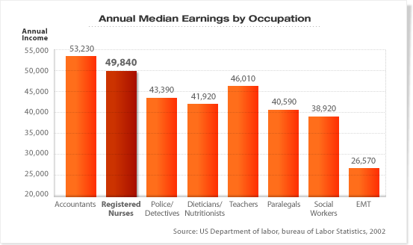
Benefits and Salaries

Slide 23

How does one know if a nursing career is right for you?
Take the NA course
Work in a health care facility
Know oneself
Be proud to say “I am a nurse”
Notes:
Consider if nursing is the right career for you. Take the nurses aide course, work in a health care facility, get to know if you like helping others, and know that nursing is a good profession.

Slide 24

Central Community College Service Area
CCC has main campuses in Columbus, Grand Island and Hastings, and learning centers in Holdrege, Kearney and Lexington. It serves a 25-county area that spans 14,000 square miles and a population of over 300,000 in central Nebraska.
For more info contact:
Community Liaison @ (308) 398-7951

